Slide 1



STORED PROCEDURE
Amiria Hia 24N10042
Yohanes Benediktus Meka Do 24N30008
Rosvirgini Kuklirip Gombo 24N30011

Slide 2

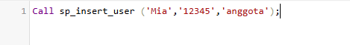
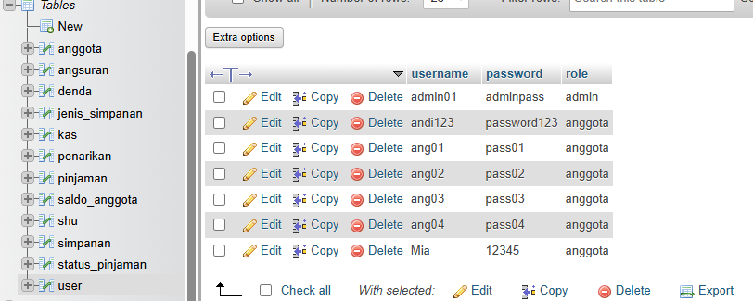
TAMBAH USER BARU
DELIMITER $$
CREATE PROCEDURE sp_insert_user(
IN p_username VARCHAR(50),
IN p_password VARCHAR(255),
IN p_role VARCHAR(20)
)
BEGIN
INSERT INTO user(username, password, role)
VALUES(p_username, p_password, p_role);
END$$
DELIMITER ;

Slide 3

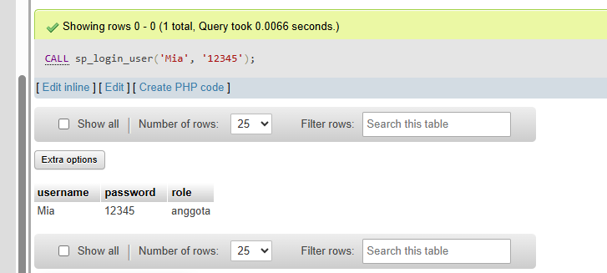
VALIDASI LOGIN
DELIMITER $$
CREATE PROCEDURE sp_login_user(
IN p_username VARCHAR(50),
IN p_password VARCHAR(255)
)
BEGIN
SELECT * FROM user
WHERE username = p_username AND password = p_password;
END $$

Slide 4

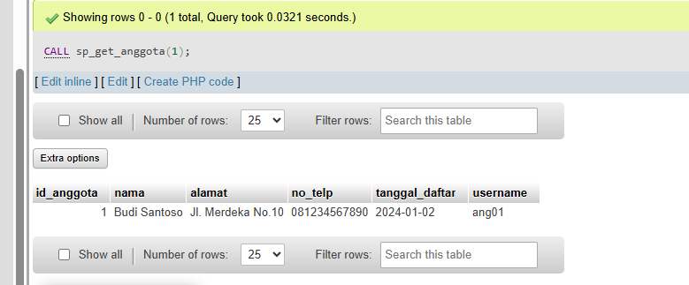
LIHAT DETAIL ANGGOTA
DELIMITER $$
CREATE PROCEDURE sp_get_anggota(
IN p_id INT
)
BEGIN
SELECT * FROM anggota WHERE id_anggota = p_id;
END $$

Slide 5

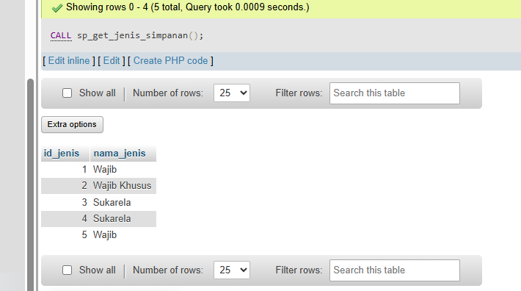

MENAMPILKAN SEMUA JENIS SIMPANAN
DELIMITER $$
CREATE PROCEDURE sp_get_jenis_simpanan()
BEGIN
SELECT * FROM jenis_simpanan;
END $$

Slide 6

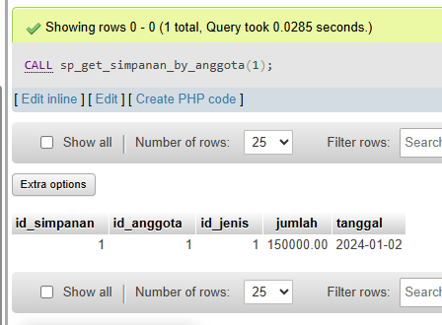


RIWAYAT SIMPANAN ANGGOTA
DELIMITER $$
CREATE PROCEDURE sp_get_simpanan_by_anggota(
IN p_id_anggota INT
)
BEGIN
SELECT * FROM simpanan WHERE id_anggota = p_id_anggota;
END $$

Slide 7
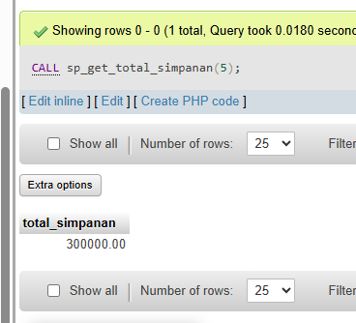
TOTAL SIMPANAN ANGGOTA
DELIMITER $$
CREATE PROCEDURE sp_get_total_simpanan(
IN p_id_anggota INT
)
BEGIN
SELECT SUM(jumlah) AS total_simpanan
FROM simpanan
WHERE id_anggota = p_id_anggota;
END $$

Slide 8
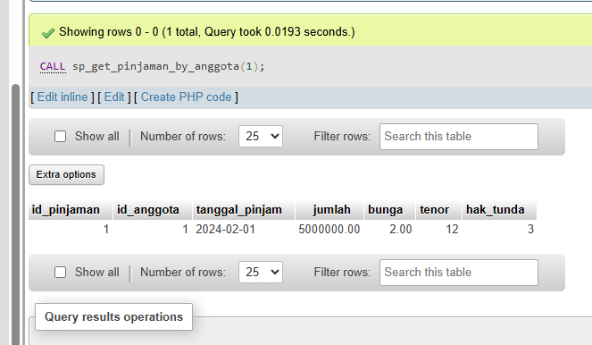
DAFTAR PINJAMAN ANGGOTA
DELIMITER $$
CREATE PROCEDURE sp_get_pinjaman_by_anggota(
IN p_id_anggota INT
)
BEGIN
SELECT * FROM pinjaman WHERE id_anggota = p_id_anggota;
END $$

Slide 9
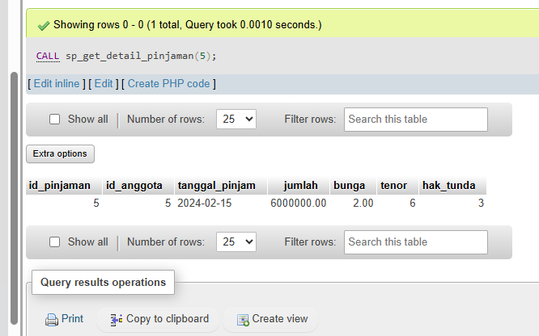
DETAIL PINJAMAN
DELIMITER $$
CREATE PROCEDURE sp_get_detail_pinjaman(
IN p_id_pinjaman INT
)
BEGIN
SELECT * FROM pinjaman WHERE id_pinjaman = p_id_pinjaman;
END $$

Slide 10


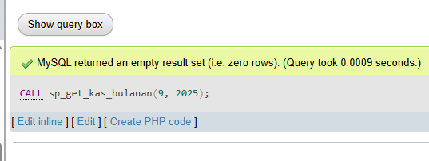

LAPORAN KAS BULANAN
DELIMITER $$
CREATE PROCEDURE sp_get_kas_bulanan(
IN p_bulan INT,
IN p_tahun INT
)
BEGIN
SELECT * FROM kas
WHERE MONTH(tanggal) = p_bulan AND YEAR(tanggal) = p_tahun;
END $$

Slide 11





TERIMA
KASIH

